Slide 1
Inspired by the Sea
Day 1
Watch these two videos about the sea. Make a
T-chart in your reading response notebook. Jot down notes about each video of the sea.
http://www.youtube.com/watch?v=7Ktkgeib6l8
http://www.youtube.com/watch?v=y1TxLBXx_FQ&feature=related
Video one – calm sea | Video two – storm at sea

Slide 2
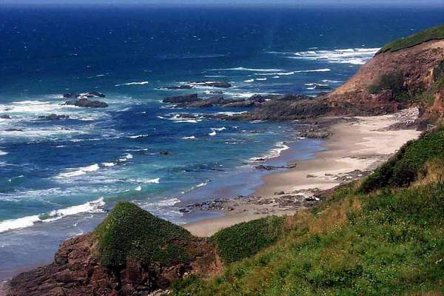
Essential Question
Why does the sea inspire writers?
In your response journal, write about how the sea could inspire writers.

Slide 3
Literature
Day 2
G I will use information from the text to describe characters and their actions in the story.
Rate yourself
1 – 2 – 3 - 4
A Think back to The Stories Julian Tells. We used character traits to describe Julian. Turn and tell a partner what some of those character traits were.

Slide 4

N To better understand a character in a story, the reader must be “read between the lines”. This means the reader must see what a character says, thinks, or does and then draw conclusions.
Some stories have many characters and some may only have a few.

Slide 5

A While I am reading the first part Amos & Boris today, I want you to think about Amos. Use the character sketch sheet to record some things you learn about Amos. We can add to the character sketch tomorrow.

Slide 6
 | Details from the text | What this shows the reader (character traits shown)
What he/she says
What he/she thinks
What he/she does
What others think
Physical Appearance

Slide 7
G
I will use information from the text to describe characters and their actions in the story.
Rate yourself
1 – 2 – 3 - 4
Rate your effort today
1-2-3-4

Slide 8
Text Talk
miserable
evaded

Slide 9
Literature
Day 3
G I will use information from the text to describe characters and their actions in the story.
Rate yourself
1 – 2 – 3 - 4
A Turn and tell your partner why it is important to understand the characters and their actions in a story.

Slide 10
N Characters are important in stories. They keep the action moving and they keep the reader interested.
Most stories have two kinds of characters: major and minor
Major Characters
- Characters in the story most often.
- They are very important to the plot.
- Their names are often in the title.
Minor Characters
- They are not as important to the plot.
-They don’t appear in the story as much.
-You don’t learn as much about a minor character as you do a major character.

Slide 11
A Yesterday we started a character sketch about Amos in the story Amos & Boris. Today we are going to continue reading Amos & Boris. You will continue to add details about Amos to your character sketch. At the end of the book, you are going to be asked to draw a conclusion about Amos. You could write about what kind of “person” Amos is and what your opinion is of him.
Listen and record as I finish the book.

Slide 12
G
I will use information from the text to describe characters and their actions in the story.
Rate yourself
1 – 2 – 3 - 4
Rate your effort today
1-2-3-4

Slide 13
Text Talk
ambitions
leisurely

Slide 14
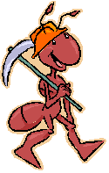
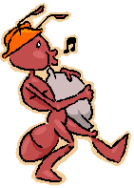
Informational Text
Day 4
G I will determine the main idea of a text and tell how key details support the main idea.
Rate yourself
1-2-3-4
A Let’s read this paragraph together. If you had to tell someone the jest of the paragraph, what would you tell them it is about. Turn and tell a partner.
Ants are very busy insects. They work hard every day to build their nest and find food. When ants find food they carry it back to their nest. Sometimes the piece of food they find is bigger than they are. The ants do
not have an easy job.

Slide 15
N The main idea is what the author wants you to remember most.
Look at our example.
Main Idea
Ants
Ants are very busy insects. They work hard every day to build their nest and find food. When ants find food they carry it back to their nest. Sometimes the piece of food they find is bigger than they are. The ants do not have an easy job.
Details
The main idea is ants are very busy insects. Notice how the author supports the main idea with three strong details. The other sentences in the paragraph are called details. Details describe or explain the main idea.

Slide 16
A Let’s practice finding the main idea in a paragraph.
http://www.manatee.k12.fl.us/sites/elementary/samoset/mainideaprac.htm

Slide 17
G
I will determine the main idea of a text and tell how key details support the main idea.
Rate yourself
1-2-3-4
How was your effort?
1-2-3-4

Slide 18
Informational Text
Day 5
G
I will determine the main idea of a text and tell how key details support the main idea.
Rate yourself
1-2-3-4
A
Watch this video about sea turtles. Turn and tell a partner what the main message of the video.
http://www.youtube.com/watch?v=h141_qEOGpI

Slide 19
N The main idea is what the author says about the subject of the paragraph. It is the point the author wants you to understand.
Sometimes the author tells the main idea right in the first sentence. In paragraphs like that, it is easy to find what the main idea is. In other types of paragraphs, the main idea is not so easy to find. You have to read to find the main idea.
http://www.youtube.com/watch?v=W24RyhtX1qA
Watch this video to learn more about finding the main idea and details in a paragraph.

Slide 20
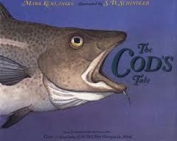
A Today I am going to read The Cod’s Tale. This is an informational book about cod fish.
Each page of the book has a heading with a main idea and details.
Read pages 1-11 aloud.
Now it is your turn to find the main idea. Every will get a copy of pages 12-13. The heading for these pages is Enemies. You will work with a partner to find the main idea and three details about the pages Enemies.

Slide 21
I will determine the main idea of a text and tell how key details support the main idea.
Rate yourself
1-2-3-4
How was your effort?
1-2-3-4
G

